Slide 1

1st Meeting - T3/2021
D2I - Geelong City
By,
D2I – Geelong squad
(Machine Learning Team, Data Visualization Team, Web Development Team)

Slide 2


Datasets
Small Sample Size
Non-Availability of Data Columns (Data Dictionary)
Nulls, Class imbalance and other issues
Difficult to link with external data sources
Dataset
Concerns
Only one day data (Daily Update)
Small Feature set (Few Relevant Columns)
Difficult to identify Target Variable
Data Updating Stopped (Historic Data)

Slide 3
Machine Learning
Fire Problem
Time series prediction
Wifi Problem
Tree Problem
Prediction classification and regression
Housing Development Data 2013-19
MACHINE LEARNING
Clustering and prediction
Road Segment
Drainage Pipes
Pedestrian
API and metrics
Solver and Capacity
Parking Utilization
Powercor Public Lights

Slide 4
Web development
Two step authentication
Deploy|Host the new website
Enhance visual changes | Homepage, Inner and Dashboard
Mailing Subscription
Frontend
Easy database management
Redesigned Subscription form
Fix Issues and add live news (Geelong city)
Integrate live ML models on the website

Slide 5
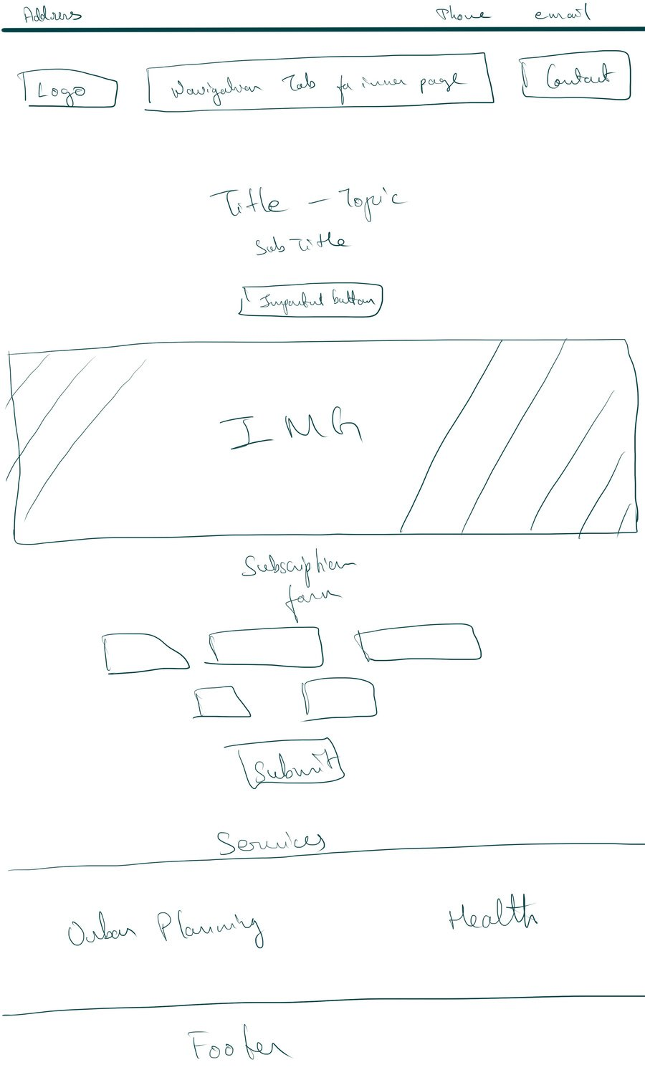
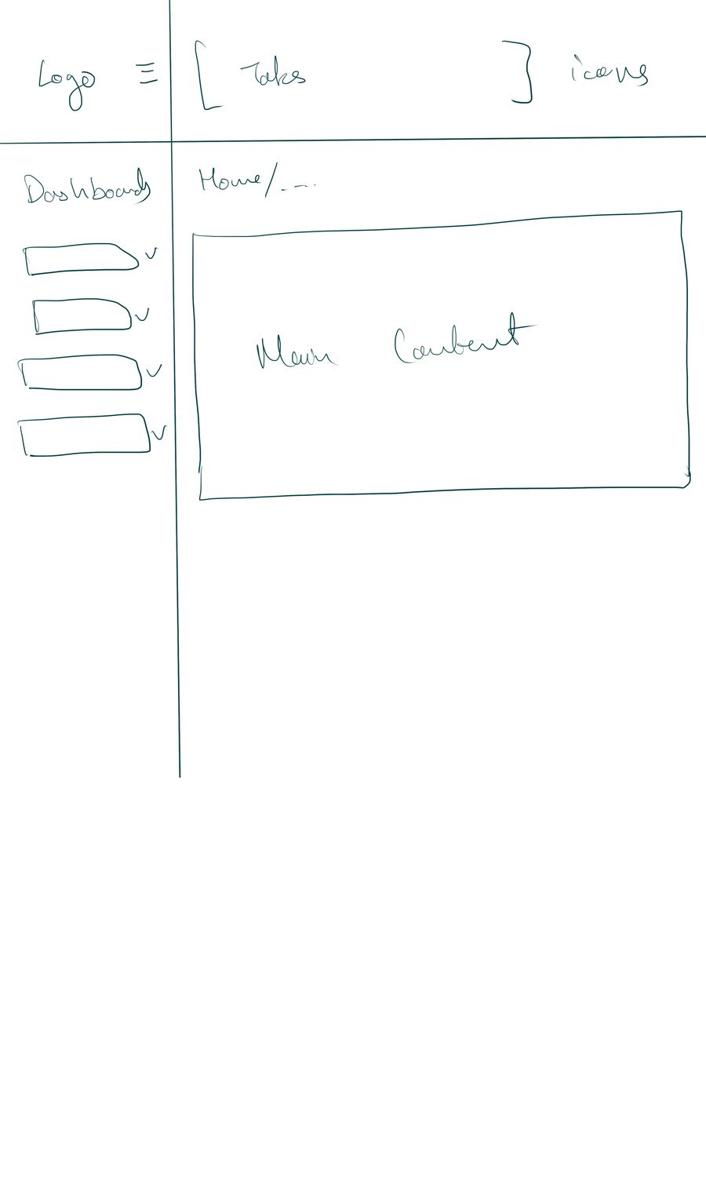
Web development
Front Page
Dashboard
Visual Changes

Slide 6

THANK YOU

